Slide 1
Optimal Strategy in Basketball
Brain Skinner and Matthew Goldman

Slide 2
11.1 Introduction
Empirical Studies of scoring can in basketabll suggest that scoring events can be modeled with a fairly high degree of accuracy as independent and identically distributued (iid).
This independence implies that, as the game progresses, the differential score undergoes a biased random walk. Its random fluctuations are therefore nearly identical to those of Brownian motion, while the net drift of the score is determined by
the skill levels of the two teams
the scoring strategies they employ.

Slide 3


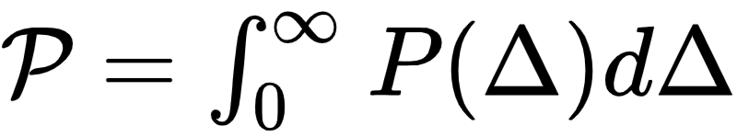
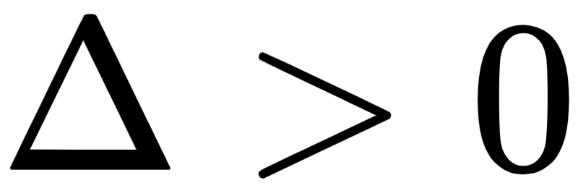
Introduction
By Central Limit Theorem, the probability density for many possessions is described by a Gaussian distribution
where
The intent of strategic decisions
Maximize the probability of victory, , the probability of ending the game with

Slide 4
Introduction
This Chapter focuses on discussing the principles associated with optimal strategy in basketball, i.e. the maximization of P.
Three Principles:
Allocative Efficiency
Dynamic Efficiency
Risk / Reward Trade-off

Slide 5
11.2 Allocative Efficiency
How does the team optimally allocate its shot attempts between different offensive options?
Naive: choose the play / player provides the highest expected return in terms of points scored
Formal
A play should be characterized by a function that describes how the expected return of the play declines with increased use.

Slide 6
Skill Curve
The relationship between efficiency and usage is called “skill curve”.
f: the average number of points scored by a given player as a function of the proportion p of poessions used by that player while he is on the court.
Implication
Highly skilled players → f(p) declines very little with increased offensive load p

Slide 7
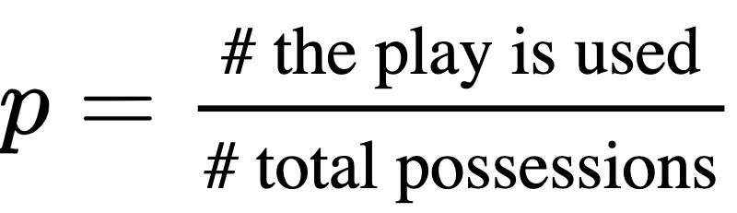
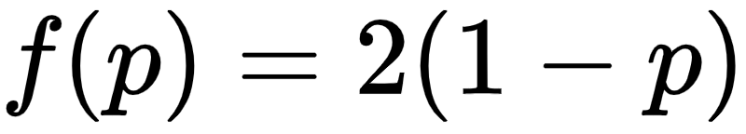
Estimate
Example
Corner three:
The corner three produces as much as two points when attempted rarely
The corner three procues nearly 0 points if it is attempted every time
All other options are assumed to produce 1.0 points per possession
Expected total number of points:
Taking derivative of p, we get

Slide 8
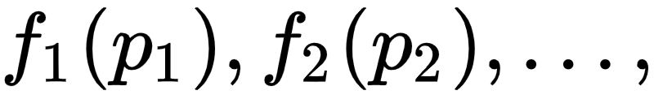


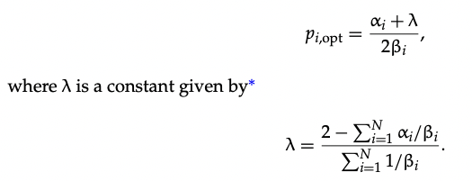
Formal Definition of Allocative Efficiency
Suppose that different plays 1, 2, 3, … are characterized by functions
Frequencies:
Expected number of points socred per possession is give by
The function is maxmized when
If f(p) are linear,
Optimal Frequency
If non-linear then we could use numerical search for maximum of F

Slide 9
Research on Allocation Efficiency
The topic of shot allocation mainly falls on the choice between two-point and three-point shots.
Also, a number of studies have sought to quantify or refine the definition of “shot value” by either examining the spatial structure behind patterns of shot effectivenss.

Slide 10


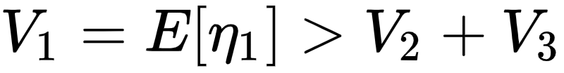
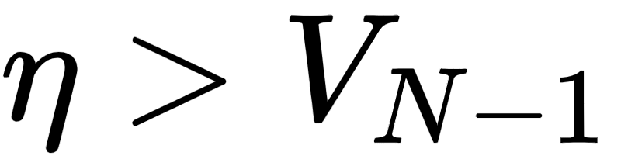
11.3 Dynamic Efficiency
The expected return of a given possession is associated with the time clock remaining, and it goes down when the clock winds down.
Hence, optimal decision-making in basketball depends on the amount of time remaining on the shot clock (“optimal stopping problem”).
Suppose you are given N “shot opportunities”, and the game ends when run out of all chances.
Question: Should you take a shot or not?
If N = 1, then take the shot, the winning percentage is the expectation of shot quality
If N = 2, then only take the first shot when
Similarly, when N = 3, only take the first shot when
The first shot is taken only when , and at each opportunity depends on how good you are shooting from those distances.

Slide 11
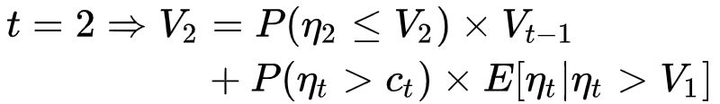

Recurrence Equation for winning probability
The distribution of shot quality depends on the time remaining, which is unreasonable.
Extension
Shots should be taken only when their expected return exceeds the average value of continuing the possession

Slide 12
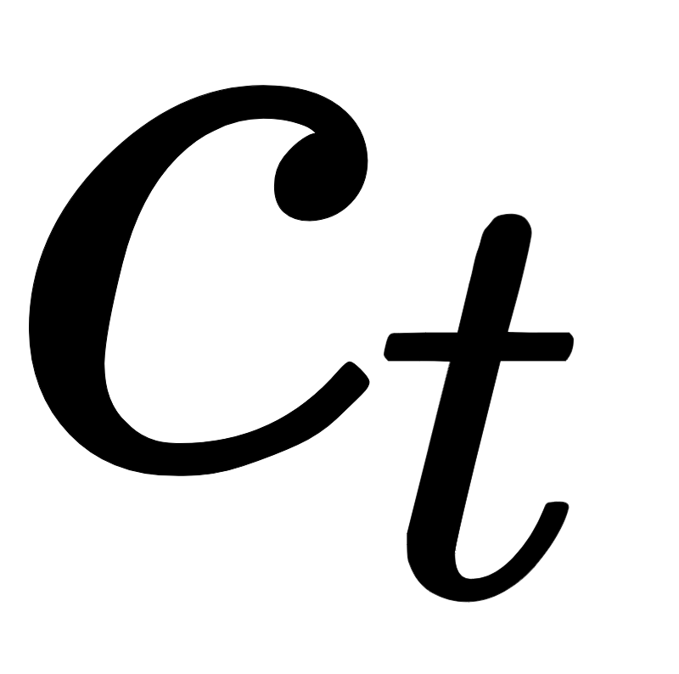

Issues and Solution
The reservation threshold cannot be measured easily, because
The average number of points scored by shots taken at time t can be observed.
But the average includes some high-value, wide open shots that are not representative of the team’s reservation threshold.
So, doesn’t gurantee optimal dynamic efficiency.
Solution
Goldman and Rao (2014b) studied the question of dynamic efficiency by estimating a structural model where the time remaining on the shot clock is used as an intrumental variable for shot selection.
In this way, they were able to model the marginal (or worst) shot a team is willing to take and compare its quality to the average number of points returend from continuing the possession

Slide 13
11.4 Risk and Reward
In a shooting contest, you can take 10 shots. If free throw shots are worth 2 points and three-poing shots are worth 3, and you know you are a 60% free throw shooter and a 40% three-point shooter. Which shots would you take?
This entirely depends on whether your friend is a better shooter than you are. Both strategies have the same expected outcome, 12 points, but the variances of outcome are different. In particular, the three-point-shooting strategy offers both a higher “best case scenario” and a lower “worst-case scenario”.
If winning is likely (i.e. you are a better shooter than your friend), then you should go with the more conservative two-point shooting strategy. Otherwise, you should choose the more risky three-point shooting strategy.

Slide 14

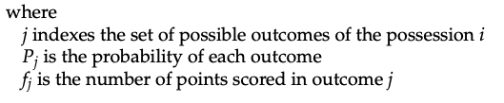

Riskness of Strategy
Riskness of strategy can be quantified by the variance of the total umber of points scored.
In the previous case, both strategies have the same expected outcome and only need to compare variance. However, most of the time the strategies have different expected outcome.

Slide 15
Ideal Strategy
When the expected number of points scored under different strategy is different, the ideal strategy involves sacrificing from the expected number of points scored to increase the variance (if you are the underdog) or reduce it (if you are the favorite).
Graphically, one can say that the strategy adpoted by each team is characterized by a distribution of possible final scores. For an underdog team, the best interest to choose a strategy that maximizes the overlap between the two teams’ distributions.

Slide 16
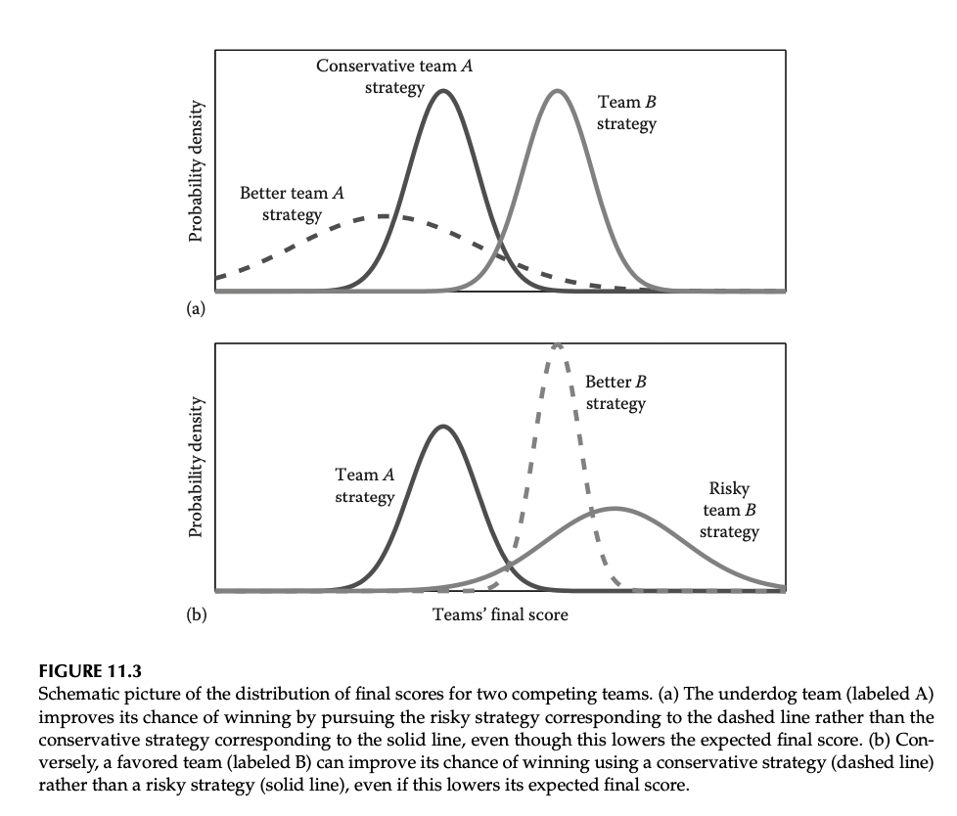
Graphical Representation

Slide 17
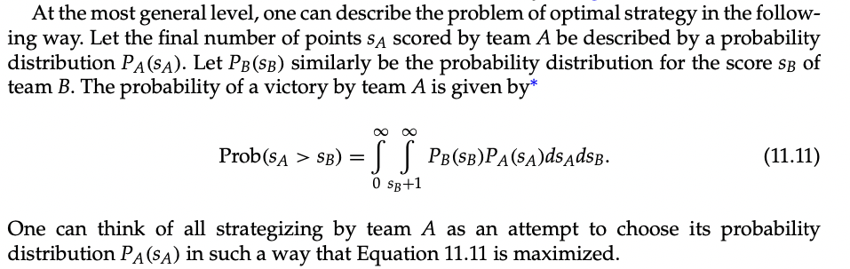
Modeling in Math

Slide 18
Game Theory
The optimal strategy of A requires one to know the stratgey of B, and team B is similarly engaged in strategic decisionmaking that requires knowledge about the strategy of A.
Thus, all strategic decisions are game-theoretical in nature and require complicated analytical descriptions.
In practice, each team can use its opponent’s previous record as an indicator of their intended strategy and ability and adopt their own strategy accordingly.
The degree to which approach can be expected to succeed or can be exploited by a clever opponent, has not been exploored in a rigorous way, but may prove a fascinating topic for future studies

Slide 19
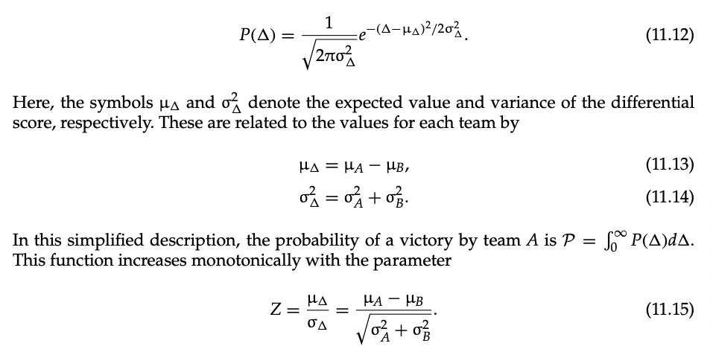
Simplified Assumption
If all possessions are independent, then the differential score distribution is Gaussian.
The optimal strategy is the one maximizes Z.

Slide 20

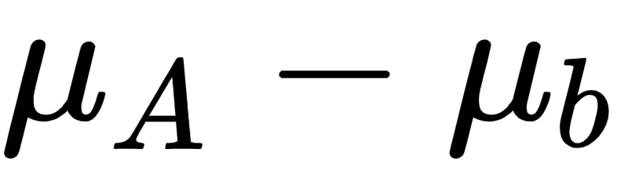
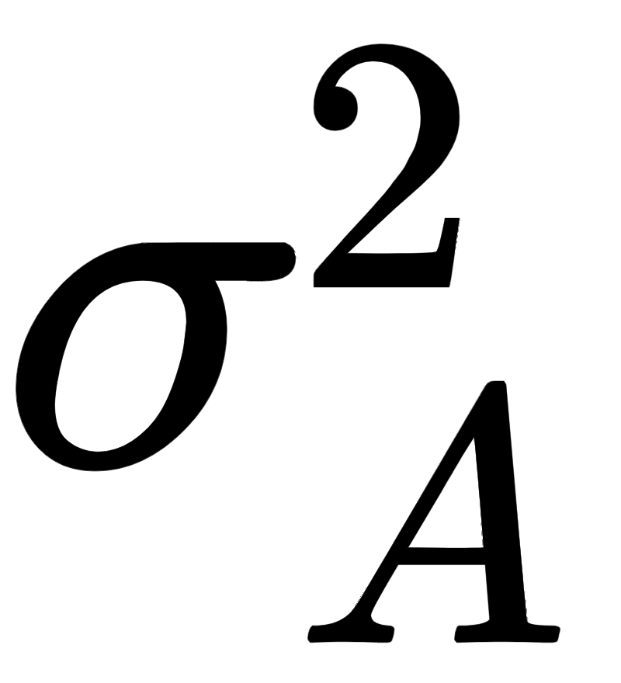
Intuition
When is negative, Z is increased by increasing
Similarly, if is positive, Z is increased by decreasing variance.

Slide 21
Dicussions
Most of the discussions surrounding the performance of actual basketball teams concerns efforts to increase a team’s expected scoring , or decrease their opponents’ expected scoring
However, there are a variety of strategies designed primarily to alter the variance of the outcome. The most common technique is the choice of shot selection, in particular, the choice to increase or decrease the proportion of three-point shots taken. Another way is to manipulate the game clock by calling timeouts or using the full length of a possession, or intentional fouling.

Slide 22
Potential Direction
I would like to go futher on allocative efficiency, to read some papers and see how others model spatial data to say why people should take more three-points shots instead of mid-range shots.

